Slide 1
Identity Obsession: What is it and Why It Should Be Avoided
Peter Ritchie

Slide 2


Slide 3
Abstract
Identity Obsession is a code smell that can occur in the context of Domain-Driven Design where entity identities are misinterpreted as always being global identities. This session details how it can happen, how you can recognize it, and the issues that arise and solutions:
Leaking domain model in API responses and separating response model from domain model
Leaking data model in API responses and separating response model from data model
Leaking primary keys in non-aggregate root entities and abstracting data model with Entity Framework
How everything having global identity affects local identities and what to do about it

Slide 4
About me
Freelance technologist specializing in helping teams deliver software solutions
Software Architect
Fractional Solution Architect
Fractional Developer Lead
In industry for over 30 years
Author of 3 books on .NET Development
Former Microsoft MVP award in .NET (13), ASP.NET Insider
Certified Azure, SAFe, and SOA

Slide 5
Agenda
Domain-Driven Design, Clean Architecture, a quick refresher
What is Identity Obsession
Inspirations
Examples and drawbacks
A focused alternative
Being successful

Slide 6
Quick Refresher of Domain-Driven Design/ Clean Architecture

Slide 7
Refresher: Entities
Not defined by its properties or attributes, but by its identity
Something philosophically the same through time despite attributes changing
Identifier: A name or number for an entity, regardless of changes

Slide 8
Refresher: Aggregates/Consistency Boundary
An Entity that contains (aggregates) other entities
Has consistency rules involving contained entities
But independent of consistency rules of each entity
Implements an interface to access child entities

Slide 9
Refresher: Layers
Domain/Core Layer
Focuses on Business Logic.
No External Dependencies.
Application/Use-Cases Layer
Contains Application integration logic that references Infrastructure and Domain
Data Layer
Sometimes part of Infrastructure Layer.
Hides implementation details from other layers.

Slide 10
Identity Obsession

Slide 11
Why Identity Obsession?
A term I coined to represent the rote application of identity to types across a codebase
Inspired by Primitive Obsession
Addressing primitive obsession often multiplies complexity of identity obsession

Slide 12
Primitive Obsession
Primitive Obsession is using primitive/intrinsic data types to represent domain ideas.

Slide 13
Identity Obsession
All Entities are modeled with an identifier, and all implemented Entities have a public Id property whether they are used by business logic or not.

Slide 14
Example Model

Slide 15
Example Aggregate
public class Order(OrderId id) {
public OrderId Id { get; } = id;
public IEnumerable<OrderLine> Items => items;
public void AddItem(OrderLine orderLine) {
if (items.Any(i => i.Product.Sku
== orderLine.Product.Sku))
{
var existingItem = items.First(i => i.Product.Sku
== orderLine.Product.Sku);
existingItem.Quantity += orderLine.Quantity;
return;
}
items.Add(orderLine);
}

Slide 16
public class Order(OrderId id) {
public OrderId Id { get; } = id;
public IEnumerable<OrderLine> Items => items;
public void AddItem(OrderLine orderLine) {
if (items.Any(i => i.Product.Sku
== orderLine.Product.Sku))
{
var existingItem = items.First(i => i.Product.Sku
== orderLine.Product.Sku);
existingItem.Quantity += orderLine.Quantity;
return;
}
items.Add(orderLine);
}
Avoiding Primitive Obsession
public class OrderId(Guid value)
{
public Guid Value { get; } = value;
}

Slide 17
Obsessed
public class OrderLine {
[SetsRequiredMembers]
public OrderLine(OrderLineId id, Product product, uint quantity)
:this(id) {
Product = product;
Quantity = quantity;
}
public OrderLineId Id { get; }
public required Product Product { get; init; }
public required uint Quantity { get; set; }

Slide 18
public class OrderLine {
[SetsRequiredMembers]
public OrderLine(OrderLineId id,
Product product, uint quantity)
:this(id) {
Product = product;
Quantity = quantity;
}
public OrderLineId Id { get; }
public required Product Product { get; init; }
public required uint Quantity { get; set; }

Slide 19
Use Case
public class OrderService {
public OrderId CreateOrder(ICollection<ProductDto>
productDtos)
{
OrderId orderId = new();
Order order = new(orderId);
foreach (var item in productDtos) {
var product = productRepository.
FindBySku(item.Sku);
OrderLine orderLine = new(new OrderLineId(),
product, item.Quantity);
order.AddItem(orderLine);
}
orderRepository.Save(order);
return orderId;
}

Slide 20
public class OrderService {
public OrderId CreateOrder(ICollection<ProductDto>
productDtos)
{
OrderId orderId = new();
Order order = new(orderId);
foreach (var item in productDtos) {
var product = productRepository.
FindBySku(item.Sku);
OrderLine orderLine = new(new OrderLineId(),
product, item.Quantity);
order.AddItem(orderLine);
}
orderRepository.Save(order);
return orderId;
}

Slide 21
Serialization Concerns
Id properties are used only for serialization/persistence
Never used in business logic
Creation of identities is forced into Application layer
Infrastructure concern leaking into Application

Slide 22
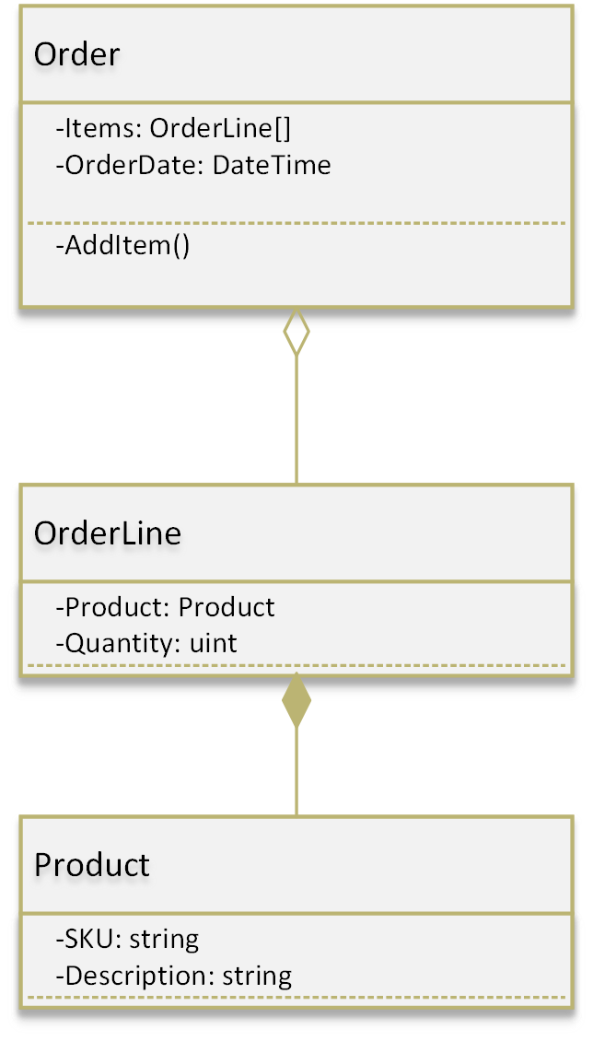
Un-obsessed

Slide 23
Un-obsessed Code

Slide 24
Un-obsessed
public class OrderLine(Product product,
uint quantity)
{
public Product Product { get; init; } = product;
public uint Quantity { get; set; } = quantity;
public OrderLine(uint quantity)
: this(new Product(""), quantity)
{
}
}

Slide 25
public class OrderLine(Product product,
uint quantity)
{
public Product Product { get; init; } = product;
public uint Quantity { get; set; } = quantity;
public OrderLine(uint quantity)
: this(new Product(""), quantity)
{
}
}

Slide 26
Un-obsessed Use Case
public class OrderService
{
public OrderId CreateOrder(IReadOnlyCollection<ProductDto>
productDtos)
{
Order order = new();
foreach (var item in productDtos)
{
var product = productRepository.
FindBySku(item.Sku);
OrderLine orderLine = new(product, item.Quantity);
order.AddItem(orderLine);
}
return orderRepository.Save(order);
}

Slide 27
public class OrderService
{
public OrderId CreateOrder(IReadOnlyCollection<ProductDto>
productDtos)
{
Order order = new();
foreach (var item in productDtos)
{
var product = productRepository.
FindBySku(item.Sku);
OrderLine orderLine = new(product, item.Quantity);
order.AddItem(orderLine);
}
return orderRepository.Save(order);
}

Slide 28
Benefits
Simpler, more focused domain code
IDs don’t leak into domain code lessening the use of primitives
Reduced complexity
Reduced boiler-plate domain code
Looser coupling

Slide 29
Ramifications/Complications
DbContext implementation more complex
Implementation hiding logic
DbSet is not a repository implementation
Consider a repository implementation that wraps the DbContext and or a DbSet
Accidental complexity hides issues

Slide 30
SKU?
Natural key
Still using string.
public record ProductSku {
public ProductSku(string value) {
if (!IsValid(value))
{
throw new ArgumentException("Invalid SKU format", nameof(value));
}
Value = value;
}
public string Value { get; init; }
internal static bool IsValid(string sku) {
var match = Regex.Match(sku, @"^(\w\w)(S\d\d)(\w)(\d\d\d)$");
return match.Success;
}
}

Slide 31
Recommendations
Limit options only at the last responsible moment
Restrict identity in domain/core code to aggregates
Only if it’s needed
Leave “identity” off non-aggregate entities as an implementation detail (i.e., database schema, handled by Repository)
Embrace local identities in domain/core code
E.g.: Account.Customer
Reflect on potentially leaked implementation details and iterate.

Slide 32
Thank you!

Slide 33






Peter Ritchie
@peteraritchie
/in/peteraritchie
peteraritchie
peter@peterritchie.com
/profile/peterritchie.com

